Slide 1

Complexity Classes &
NP-Hard Problems
CISC 610
Data Structures & Algorithms
Caleb Druckemiller, MSC

Slide 2
What are we doing today?
Chapter 13, generally
Complexity Classes
Theoretical basis
FSA/PDA/Turing Machines
Complexity classes, generally
A brief discussion of the most common complexity classes
NP/NP-hard/NP-complete

Slide 3
Let’s Talk about the Chapter
Chapter 13 was a bit of a review
Algorithm classification
Run-time complexity
Divide-and-conquer, dynamic programming, greedy algorithms
Mergesort
Djikstra’s algorithm
There were a few decent tips on algorithm design
The main concept we need to talk about is:
Complexity Classes

Slide 4
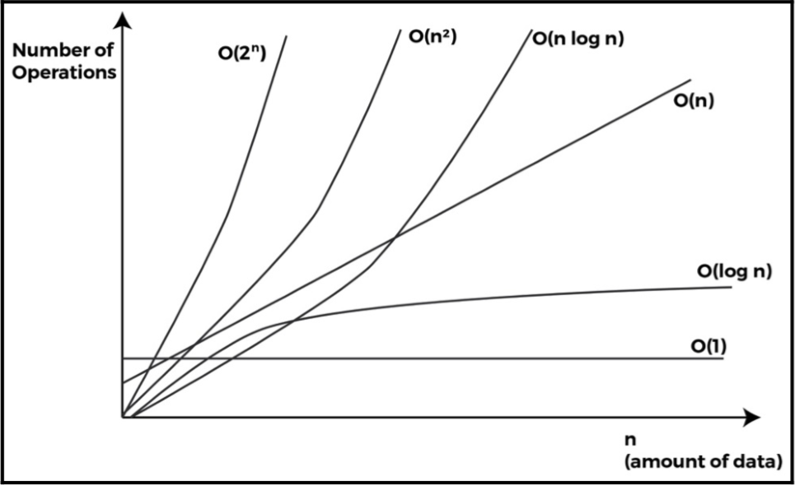
Complexity Classes?
Informally, broad categories that describe how easily completable an algorithm is (and on what machine)
We’ve already seen something that’s sort of related:
These roughly describe how long an algorithm takes to finish
But each of these algorithms WILL finish…

Slide 5
CISC 603: Theory of Computation in 10 minutes
In order to understand what a complexity class is, we need to understand what a Turing machine is
Named for Alan Turing OBE FRS (1912-1954)
Mathematician who proposed the conceptual model of a Turing Machine
Also:
Proposed the Turing test, a theoretical framework to test if a machine is intelligent
Helped defeat the Nazis

Slide 6
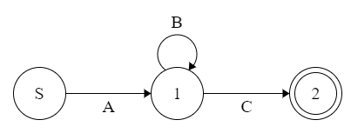
CISC 603: Theory of Computation in 10 minutes
All algorithms are a series of instructions to complete a task
Suppose we wanted to read in a file
The file starts with a header line, has any number of detail lines, and then ends with a summary line
Let A be the header line, B be the detail lines, and C be the summary line
We could diagram a machine for this algorithm as such:

Slide 7
CISC 603: Theory of Computation in 10 minutes
Called a Finite State Machine or Finite State Automaton
FSM or FSA
Very powerful for pattern recognition
Can represent/accept any regular expression
Acceptance means “can process”
Consider if you programmed our file processor as above
You are assuming the file starts with 1 header line
What happens if you get 2? Or don’t get any?

Slide 8
CISC 603: Theory of Computation in 10 minutes
Does this thing have memory?
Not really…
It has a history of transitions but can’t really do anything dynamic based on it
Let’s go back to our file processor
Suppose each detail line is an equation, including parentheses
We want to make sure that the parentheses are appropriately balanced

Slide 9
CISC 603: Theory of Computation in 10 minutes
How would we do this with our FSA?
We’d have to program one to check for every conceivable equation
NOT PRACTICAL
But what if we could store our parens?
We process as many symbols until we see a left parent
When we see a left paren, we store it
When we see a right paren, we make sure we have already stored a left paren
When the string and stack are empty, you’re good!

Slide 10
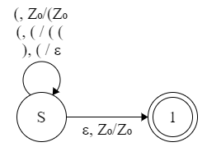
CISC 603: Theory of Computation in 10 minutes
Pushdown Automaton
PDA
Basically, an FSA with a stack!
Much more powerful
Can recognize regular and context-free expressions
When we see a left paren, we store it
When we see a right paren, we make sure we have already stored a left paren
When the string and stack are empty, you’re good!

Slide 11
CISC 603: Theory of Computation in 10 minutes
We’re still stuck moving in one direction
Through the machine…
…And through the input
Instead of being force-fed a one-way stream of input, imagine our input is on an infinitely long tape
You can move forward or backward through the tape
You can read from or write to the tape
You can move between states by the contents of the tape or your actions (read/write)
Congratulations! You just invented a Turing Machine!

Slide 12
Turing Machines
It’s also a computer?
Turing also hypothesized about a single machine that could compute (accept) any computable sequence
The Universal Turing Machine
Definition laid the groundwork for store-program computing
The only major difference between the theoretical Turing Machine and a modern computer is the infinite tape
Computers don’t have infinite memory
Mathematically provable that for any algorithm confined within finite memory, a Turing Machine can be created to solve it

Slide 13
What Does this have to do with Complexity Classes?
Complexity classes are defined by performance or requirements on a type of Turing Machine
Typically we will examine the time complexity (number of steps)
Can also be examined with respect to space complexity
Different types of Turing Machines may be mentioned
We have discussed a single-tape deterministic Turing Machine
Multi-tape, probabilistic, or nondeterministic Turing Machines are conceptually possible
If these are necessary, we will mention them
Sometimes, there’s a more intuitive definition for a class

Slide 14
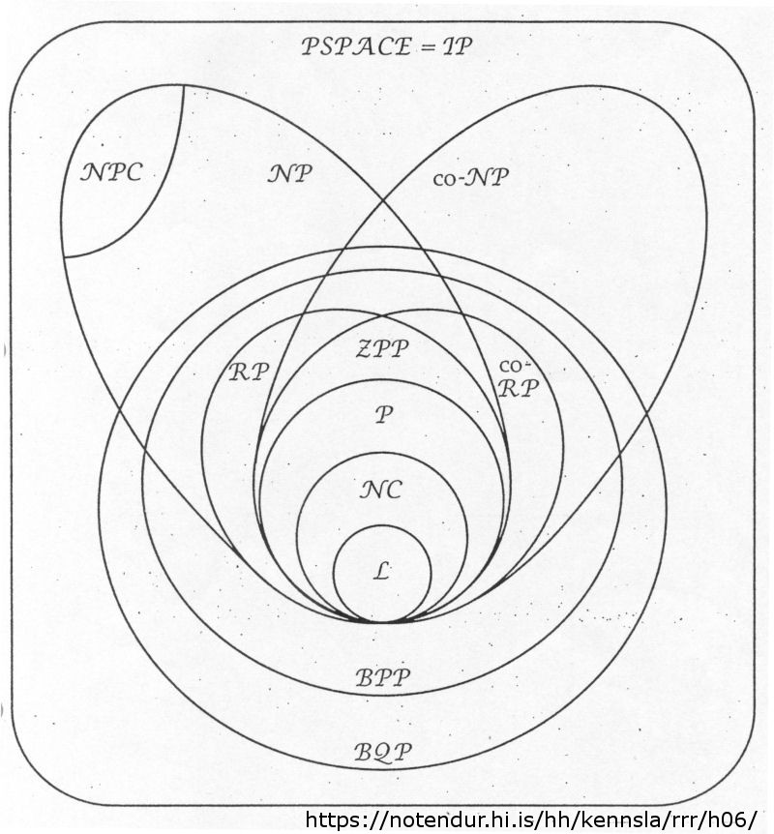
Complexity Classes, Visualized
Algorithms will fit into one of these categories
They will be discussed by the most specific category the fit
An algorithm in L is also in P and NP but we will classify it as L
We will not be discussing in great detail all of these classes but, instead, we’ll hit the highlights
Also, these are not the only classes!

Slide 15
Complexity Classes, Visualized

Slide 16
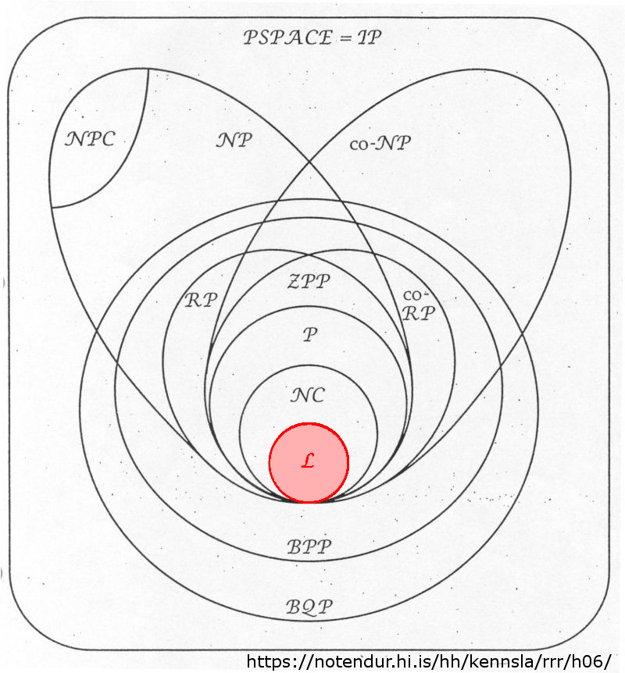
Complexity Classes, Visualized
L/L-space
Algorithms which can be completed with using a logarithmic amount of memory

Slide 17
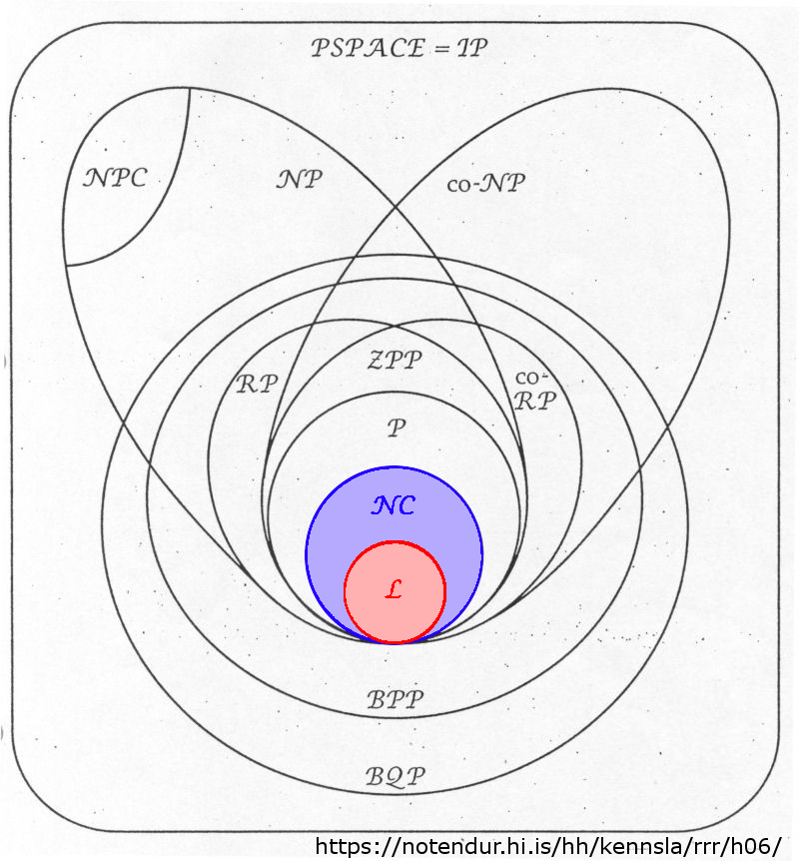
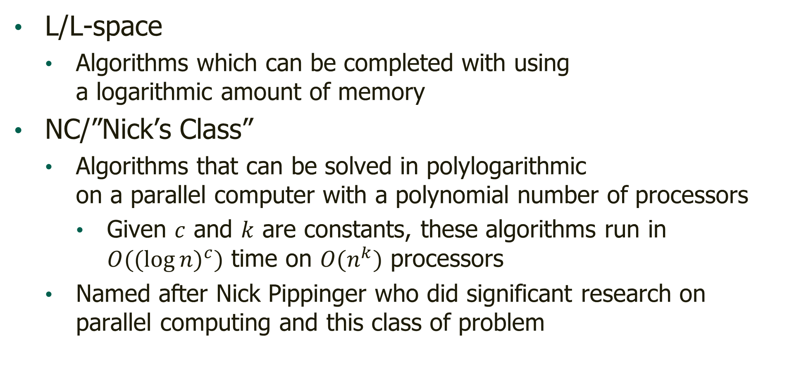
Complexity Classes, Visualized
L/L-space
Algorithms which can be completed with using a logarithmic amount of memory
NC/”Nick’s Class”
Algorithms that can be solved in polylogarithmic on a parallel computer with a polynomial number of processors
Given $c$ and $k$ are constants, these algorithms run in $O({(log{n})}^{c})$ time on $O(n^{k})$ processors
Named after Nick Pippinger who did significant research on parallel computing and this class of problem

Slide 18
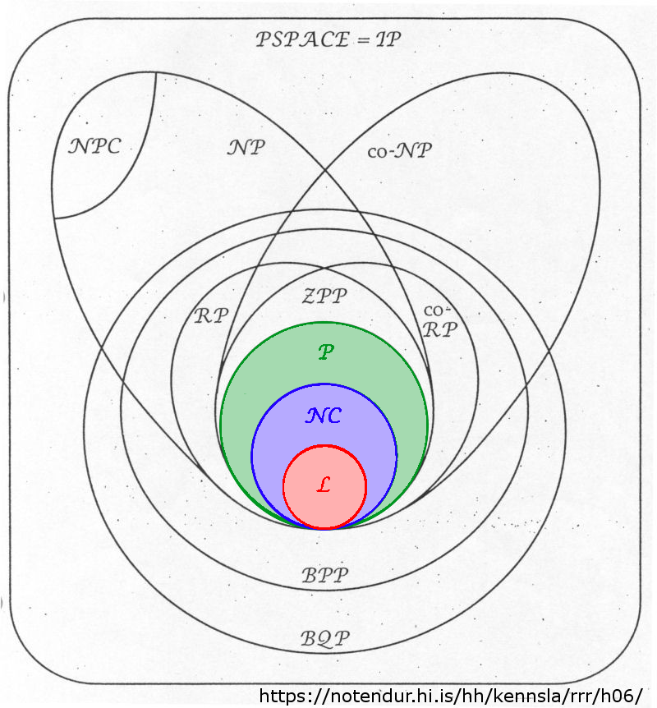
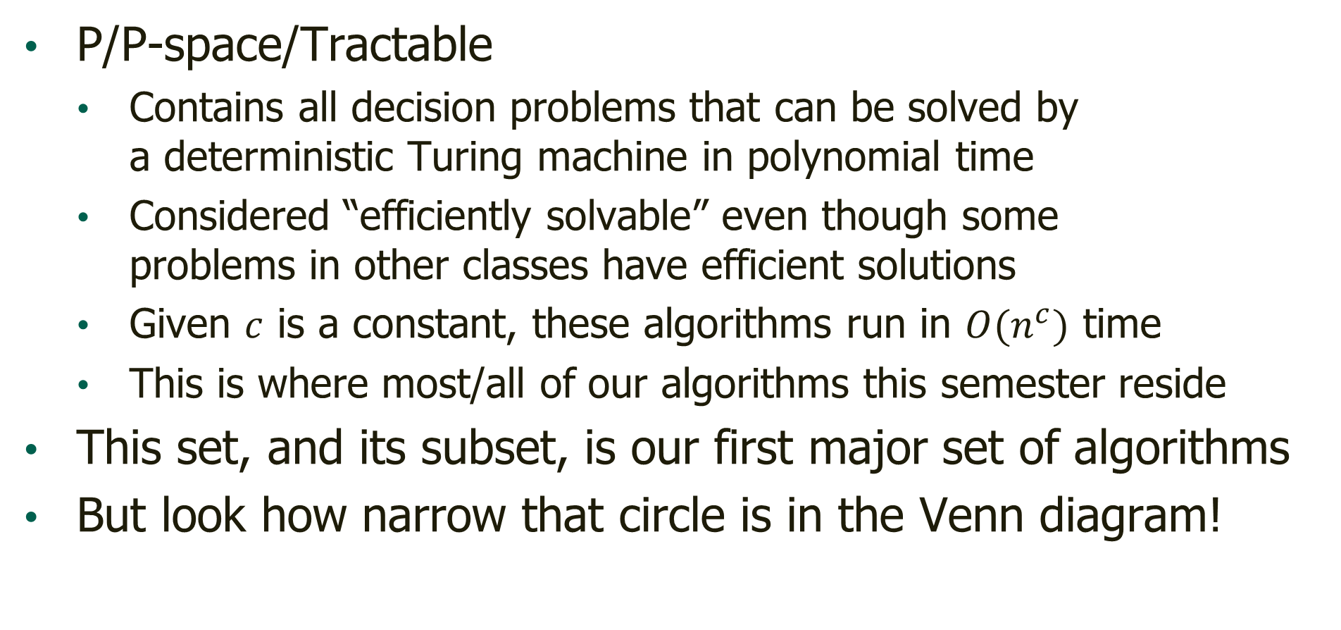
Complexity Classes, Visualized
P/P-space/Tractable
Contains all decision problems that can be solved by a deterministic Turing machine in polynomial time
Considered “efficiently solvable” even though some problems in other classes have efficient solutions
Given $c$ is a constant, these algorithms run in $O(n^{c})$ time
This is where most/all of our algorithms this semester reside
This set, and its subset, is our first major set of algorithms
But look how narrow that circle is in the Venn diagram!

Slide 19
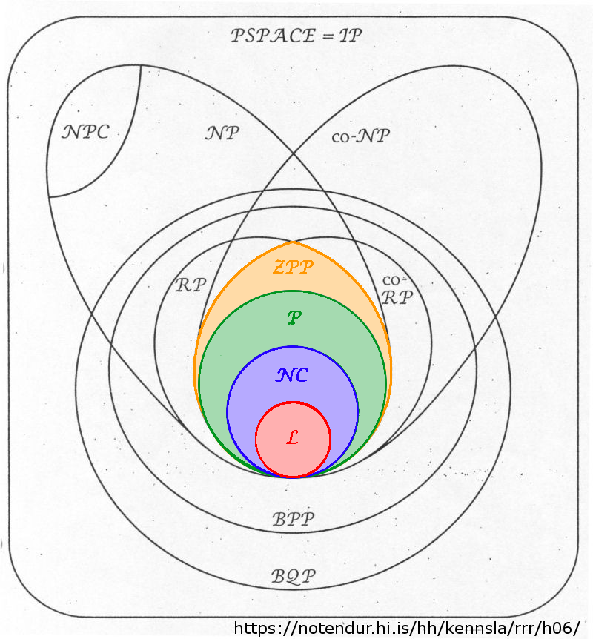
Complexity Classes, Visualized
ZPP/Zero-Error Probabilistic Polynomial Time
Contains all decision problems that can be solved by a probabilistic Turing machine in polynomial time
Always comes back with the correct answer

Slide 20
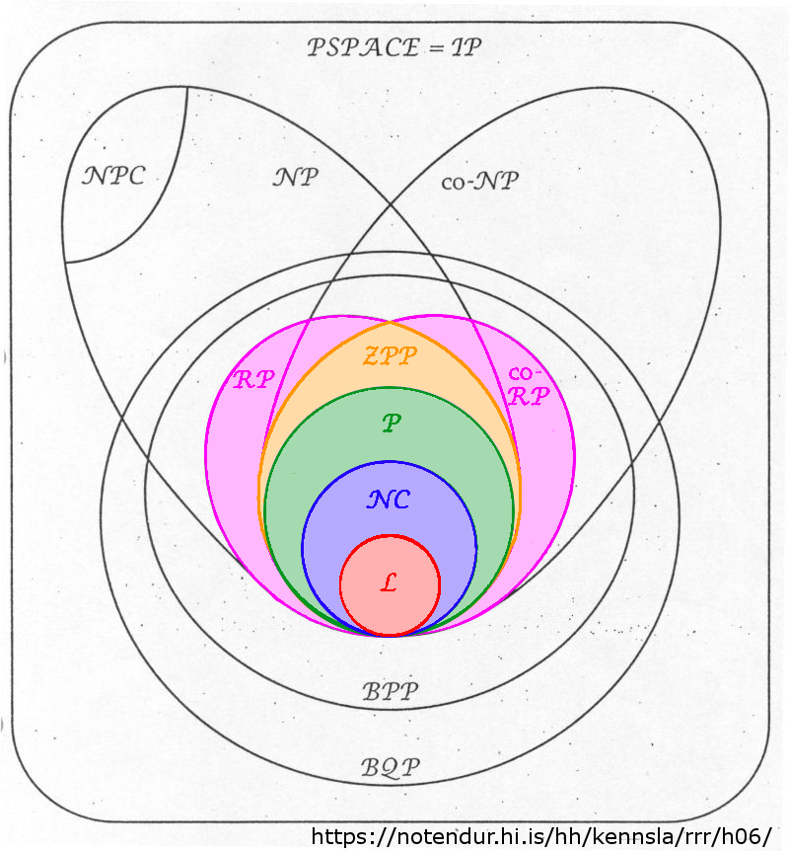
Complexity Classes, Visualized
ZPP/Zero-Error Probabilistic Polynomial Time
Contains all decision problems that can be solved by a probabilistic Turing machine in polynomial time
Always comes back with the correct answer
RP (and co-RP)/Randomized Polynomial Time
Contains all decision problems that can be solved by a probabilistic Turing machine in polynomial time
Always returns the “No” answer correctly
(Always returns the “Yes” correctly for co-RP)
Opposite answer is returned correctly with over 50% accuracy

Slide 21
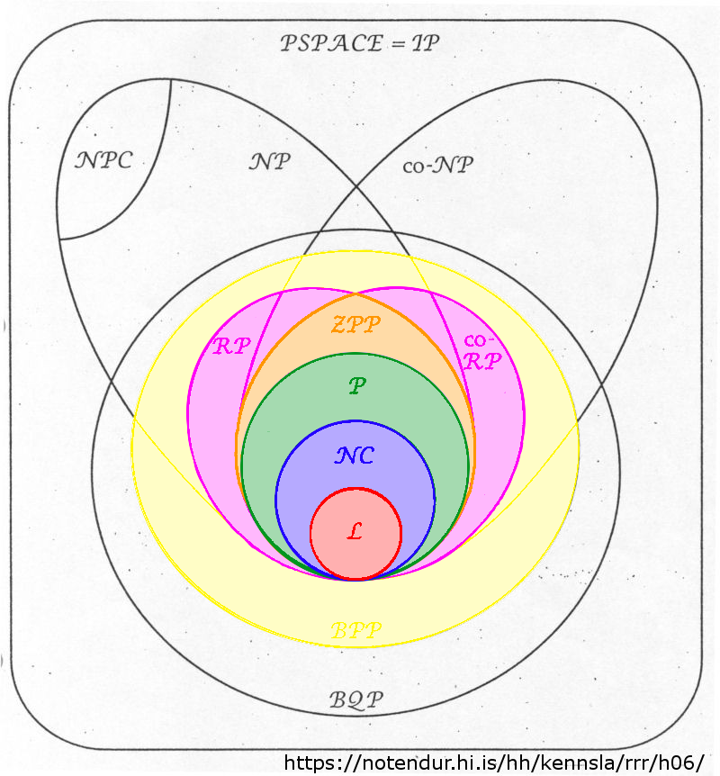
Complexity Classes, Visualized
BPP/Bounded-Error Probabilistic Polynomial Time
Contains all decision problems that can be solved by a probabilistic Turing machine in polynomial time
Will come back with the wrong answer no more than 1/3 of the time on any given run

Slide 22
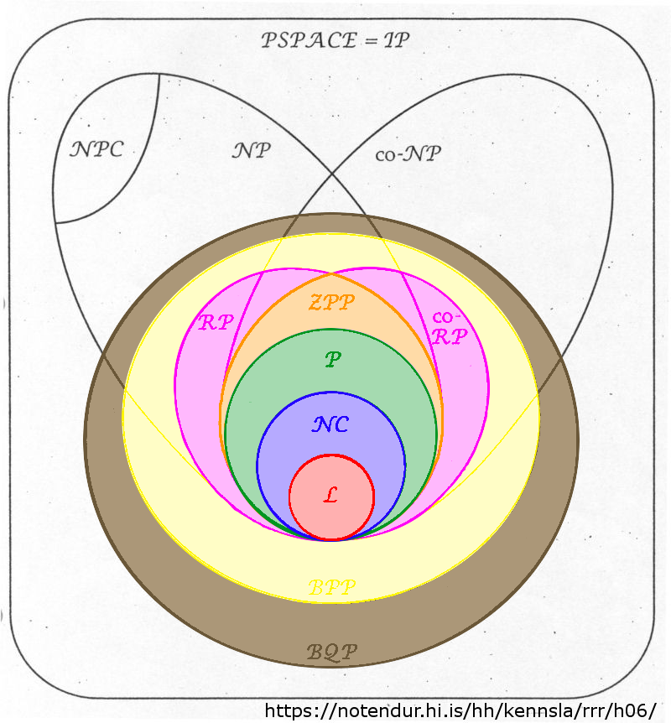
Complexity Classes, Visualized
BPP/Bounded-Error Probabilistic Polynomial Time
Contains all decision problems that can be solved by a probabilistic Turing machine in polynomial time
Will come back with the wrong answer no more than 1/3 of the time on any given run
BQP/Bounded-Error Quantum Polynomial Time
Contains all decision problems that can be solved by a quantum computer/Turing machine in polynomial time
Will come back with the wrong answer no more than 1/3 of the time on any given run

Slide 23
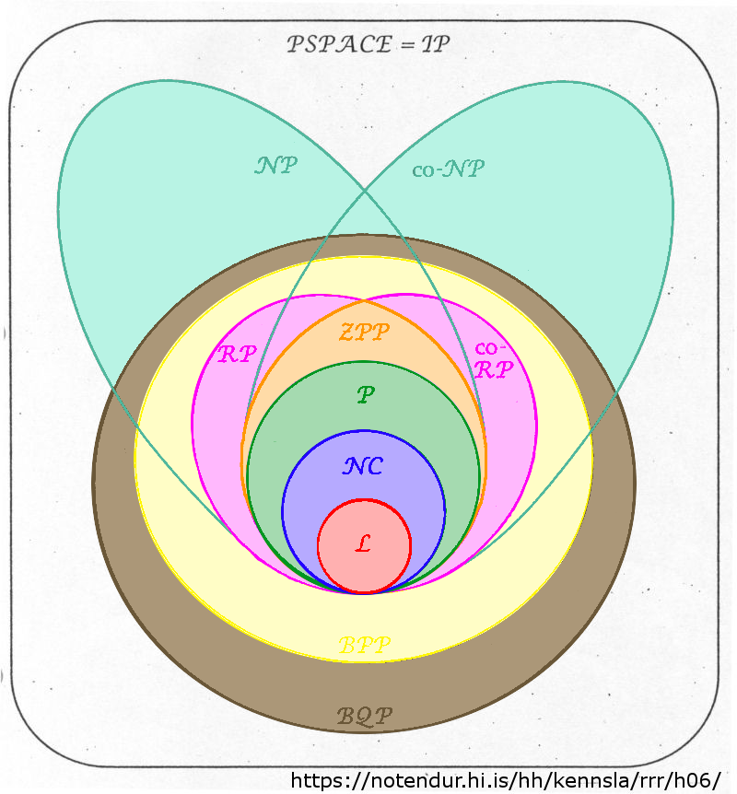
Complexity Classes, Visualized
NP/Nondeterministic Polynomial Time
Not “Non-polynomial time!”
(Although, they’re functionally the same)
Contains all decision problems that can be solved by a non-deterministic Turing machine in polynomial time
OR contains all decision problems that can be proven by a deterministic Turing machine in polynomial time
What do we mean by this? Proven versus solved?

Slide 24
Complexity Classes, Visualized
NP/Nondeterministic Polynomial Time
Consider factoring very large numbers
What is the prime factorization of:
180,065,189,893,269,259
How long will this take to figure out?
What if I told you the following is true:
3,391 × 9,391 × 59,029 × 95,791 = 180,065,189,893,269,259
How long would it take you to confirm this? (Even if you had to do this by hand?)

Slide 25
Complexity Classes, Visualized
NP/Nondeterministic Polynomial Time
This is what we mean by “provable in polynomial time”
Given an answer, we can validate it “quickly”
Co-NP is like co-RP where “no” can be validated quickly
Obviously, all P algorithms are contained within NP and co-NP
If the solution can be generated in polynomial time, then it can be validated in polynomial time

Slide 26
Complexity Classes, Visualized
NP/Nondeterministic Polynomial Time
Are we sure that these provable algorithms are not also answerable in polynomial time?
No…actually we’re not
We’re fairly certain that the set of NP algorithms is not the same as the set of P algorithms
If you can prove that either P = NP or P ≠ NP, there might be some money in it for you
So, are all NP problems the same?
NO!

Slide 27
Complexity Classes, Visualized
NP-Hard
The hardest problems which may (or may not) be a part of the NP complexity class
It’s “at least as hard” as all problems in NP
A problem is said to be NP-Hard if:
All problems from NP can be translated into it
These translations can be done in a polynomial time
A problem is NP-hard if every problem in NP can be REDUCED to it in polynomial time
So, is this it?

Slide 28
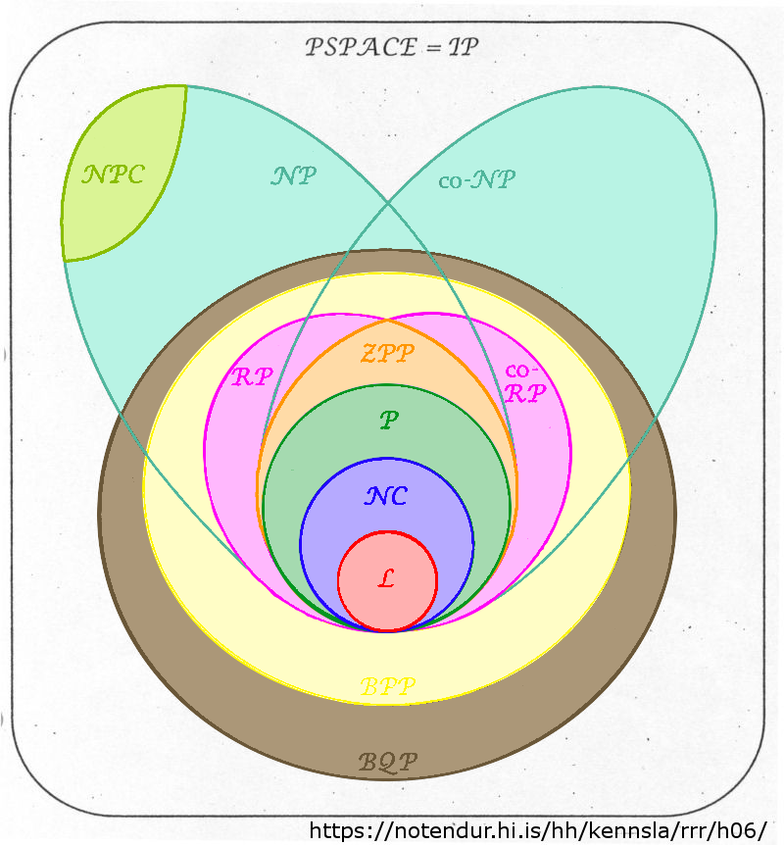
Complexity Classes, Visualized
NP-Complete
A subset of the hardest solvable problems in the NP complexity class
These problems must be both NP and NP-Hard
These problems can be solved through brute force search, such as:
Hamilton circuits
Vertex cover
Battleship (the board game)
Here’s a Wikipedia list, if you’re interested…

Slide 29
Complexity Classes, Visualized
NP-Complete
One last thing…
They are NP-Hard, meaning that all problems in NP can be reduced into any NP-complete problem in polynomial time…

Slide 30
Complexity Classes, Visualized
NP-Complete
One last thing…
…But NP-complete problems are also members of NP…
…Meaning any NP-complete problem can be reduced to any other NP-complete problem in polynomial time…
…Meaning a solution to any NP-complete problem can be used to solve any other NP-complete problem in polynomial time…
…Meaning, if we develop an algorithm for any NP-complete problem that works in polynomial time, we’ve solved them all in polynomial time…

Slide 31
Questions?

